Slide 1
Walking, policies and strategies worldwide [Pěší doprava z pohledu strategií a politik v ČR a ve světě] Yossi Zachar

Slide 2
Significance of the topic
lack of sidewalks, walking paths
lack of walking infrastructure with certain quality
increasing automobilization – 1 003 728 registered cars in Prague (TSK, 2022)
urban development focuses on cars and loses its potential
developing elements of micromobility that often endanger pedestrians
37% of Prague residents are children or pensioners (ČSÚ, 2021)
89% of walking trips in Prague are only up to 2 km long, of which 62% are not more than 1 km (Analýza stavu bezmotorové dopravy v Praze, Odbor dopravy MHMP, 03/2021)
200,000 car journeys in Prague are shorter than 1.5 km (Analýza stavu bezmotorové dopravy v Praze, Odbor dopravy MHMP, 03/2021)

Slide 3
WALK
Walking is the most basic of locomotor skills, it involves the transfer of weight from one foot to another while moving either forwards or backwards. Walking appears in every facet of everyday life. Walking to school, recovering between more intensive movements in game situations, recreational activities, and moving from one room to another at home are all examples of the need for proficient walking technique. (PDST. Move Well, Move Often: Developing the physically literate child through the lens of fundamental movement skills. Book 2 - Skills and Activities, PE Curriculum, Dublin, 2017.)

Slide 4
WALK - HEALTH VS TRANSPORT
Walking research tends to reside in two bodies of literature (health/leisure versus transport/land-use), both with their own viewpoints, methods, and policy orientations. Both approaches to walking research have suffered from a lack of objective data on walking behavior, typically relying on recall questionnaires using subjective categories of walking frequencies and durations. (MILLWARD, Hugh, Jamie SPINNEY a Darren SCOTT. Active-transport walking behavior: destinations, durations, distances. Journal of Transport Geography [online]. 2013, 28, 101-110 [cit. 2023-01-08]. ISSN 09666923. Dostupné z: doi:10.1016/j.jtrangeo.2012.11.012)

Slide 5
WALK - HEALTH VS TRANSPORT
Public health research sees walking more as a physical activity behavior, transportation research considers walking as one of multiple modes of travel. This difference influences the perspective on the duration of walking. While walkability research considers additional time spent walking as a healthy activity, transportation research considers walking in terms of impedance, and additional time spent walking thus constitutes a problem with respect to using other modes of transportation. In short, more walking is preferable from a health perspective, while less walking is preferable from a transportation perspective. (LACHAPELLE, Ugo. Reconciling the Construct of Walking in Physical Activity and Transportation Research. American Journal of Preventive Medicine [online]. 2009, 37(4), 372-373 [cit. 2023-03-03]. ISSN 07493797. Dostupné z: doi:10.1016/j.amepre.2009.06.012)

Slide 6
WALK - HEALTH
Regular walking in proper posture for 30 minutes five days a week has proven to reduce risk factors and benefit overall health in numerous ways. Walking prevents the risk of developing certain types of cancer (breast and colon), type II diabetes, cardiovascular diseases, as well as depression. (BENJAK, Tomislav. Walk your way to health: October 15 – World Walking Day. Croatian Medical Journal [online]. 2012, 53(5), 507-508 [cit. 2023-01-08]. ISSN 0353-9504. Dostupné z: doi:10.3325/cmj.2012.53.507)
It can be assumed that even a physical exercise programme, such as walking at a self-selected pace for 45–60 min might enhance mood with the associated changes in brain cortical activity. (VOGT, Tobias, Stefan SCHNEIDER, Vera BRÜMMER a Heiko K. STRÜDER. Frontal EEG asymmetry: The effects of sustained walking in the elderly. Neuroscience Letters [online]. 2010, 485(2), 134-137 [cit. 2023-01-08]. ISSN 03043940. Dostupné z: doi:10.1016/j.neulet.2010.09.001)

Slide 7
WALK - HEALTH
As a physically active level, a 10 000 steps/day walking becomes a commonly-acknowledged goal for daily fitness across the world through media. (WATTANAPISIT, A., & THANAMEE, S. (2017). Evidence behind 10,000 steps walking. Journal of Health Research, 31(3), 241–248 [cit. 2023-01-08]. Dostupné z: doi.org/10.14456/jhr.2017.30)
Within step challenge programs, the 10 000 steps goal roughly equate to 8 km of walking per day (around 1.5 to 2 h of walking). HALLAM, K. T., S. BILSBOROUGH a M. DE COURTEN. “Happy feet”: evaluating the benefits of a 100-day 10,000 step challenge on mental health and wellbeing. BMC Psychiatry [online]. 2018, 18(1) [cit. 2023-01-08]. ISSN 1471-244X. Dostupné z: doi:10.1186/s12888-018-1609-y)

Slide 8
WALK - ENVIRONMENT
Private automobiles are the least energy-efficient and most ecologically damaging means of moving people within cities; bicycles and walking are the most energy-efficient, environmentally sound and healthy forms of urban transportation; transit is in between. The speed, comfort and convenience of cars makes them formidable competitors with alternative modes particularly when perceived costs are low. To make matters worse, cars have become the most potent symbol of the consumer society.
Placing priority in transportation spending on infrastructure for preferred modes – transit, cycling, walking – and increasing the costs associated with auto use (e.g., higher road and parking fees) would help move us in the right direction. (REES, William. Ecological footprints and urban transportation. Sustainable Transport [online]. Cambridge, England: Elsevier, 2003, 3-19 [cit. 2023-02-12]. ISBN 9781855736146. Dostupné z: doi:10.1016/C2013-0-17820-8)

Slide 9
DECIDING TO WALK
The quantity of walking may be more related to how often the walking activity takes place. Once the walking activity takes place, the condition of the built environment is often the dominant factor that influences the quality of the walking activity, determining how convenient, pleasant, interesting, and safe it becomes, it is inevitable that the quality of walking is heavily determined by the condition of the built environment, since it constitutes the physical setting of the activity.
Transportation research could contribute to the understanding of how walking could be chosen in preference to other (motorized) modes of transport with respect to certain kinds of walking behavior, but many other questions should be raised as well outside of the issue of transport itself.

Slide 10
CONVINCING PEOPLE TO WALK
Walkers are not a homogenous group (as often assumed), so it is important to understand who is currently walking, their habits, behaviour, likes, dislikes, perceptions and attitudes. Once the values and perceptions of walkers are understood it is important to audit the quality of the walking environment and evaluate the gap in the product that needs closing in order to meet the demand.
Walking is an everyday activity, but it receives low priority for investment and little political interest because the image of walking is not one with which people wish to be associated. (WALKER, Jim. Promoting walking in the UK: bottling walking and making it sell. Sustainable Transport [online]. Cambridge, England: Elsevier, 2003, 564-572 [cit. 2023-02-12]. ISBN 9781855736146. Dostupné z: doi:10.1016/C2013-0-17820-8)

Slide 11
CONVINCING PEOPLE TO WALK
According to the Advertising Standards Authority (ASA) the total spent on UK car advertising in 1998 was in the order of £650 million. The walking campaign cost was less than £15 000. (JOHNSON, Daniel. Promoting walking in British cities: the case of York. Sustainable Transport [online]. Cambridge, England: Elsevier, 2003, 679-686 [cit. 2023-02-12]. ISBN 9781855736146. Dostupné z: doi:10.1016/C2013-0-17820-8)

Slide 12
DECIDING TO WALK
The highest share of car trips and the lowest share of walking trips can be found in the group of working males. Females have a higher share of walking and cycling trips. The importance of walking becomes even more obvious when studying the mode choice of elderly people of 70 and older. (Brög, Werner a Erl, Erhard. Does anyone walk anymore? Sustainable Transport [online]. Cambridge, England: Elsevier, 2003, 59-69 [cit. 2023-02-12]. ISBN 9781855736146. Dostupné z: doi:10.1016/C2013-0-17820-8)
In Switzerland it is estimated that people who walk to work pay on average up to € 800 per year more in taxes as a result. Walking is punished for its advantage and appears an expensive and unattractive form of mobility. (SAUTER, Daniel. Perceptions of walking – ideologies of perception. Sustainable Transport [online]. Cambridge, England: Elsevier, 2003, 201-209 [cit. 2023-02-12]. ISBN 9781855736146. Dostupné z: doi:10.1016/C2013-0-17820-8)

Slide 13
POLITICAL VIEWS
Based on questionnaires related to walking can be said that people think ‘Walking does not have strong political voices (cycling does)’. (TOLLEY, Rodney. Social and cultural influences on the future of walking – the experts’ opinion. Sustainable Transport [online]. Cambridge, England: Elsevier, 2003, 239-251 [cit. 2023-02-12]. ISBN 9781855736146. Dostupné z: doi:10.1016/C2013-0-17820-8)
Much of the credit for greener transport policies in England goes to local councils, which are now more active in encouraging walking, cycling and use of public transport, and to environmental groups and other advocates of green modes, who set out a cogent case for change. (SLOMAN, Lynn. The politics of changing to green modes. Sustainable Transport [online]. Cambridge, England: Elsevier, 2003, 474-487 [cit. 2023-02-12]. ISBN 9781855736146. Dostupné z: doi:10.1016/C2013-0-17820-8)

Slide 14
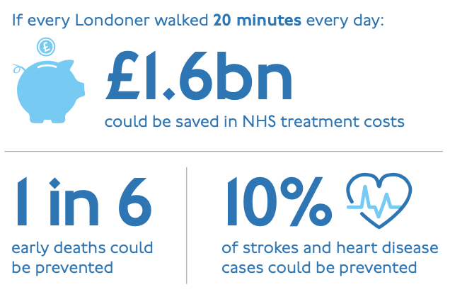
FOREIGN STRATEGIES, POLICIES
Transport for London: Walking Action Plan
building streets that prioritise people walking
optimising the management of streets
making streets safer
enhancing the accessibility and inclusiveness of London’s streets
integrating walking with public transport
leading and support a culture change
improving wayfinding
using The Healthy Streets Indicator tool
(Transport for London. Walking action plan [online]. London: TfL, 2018. [cit. 2023-06-20]. Dostupné z: https://content.tfl.gov.uk/mts-walking-action-plan.pdf)

Slide 15
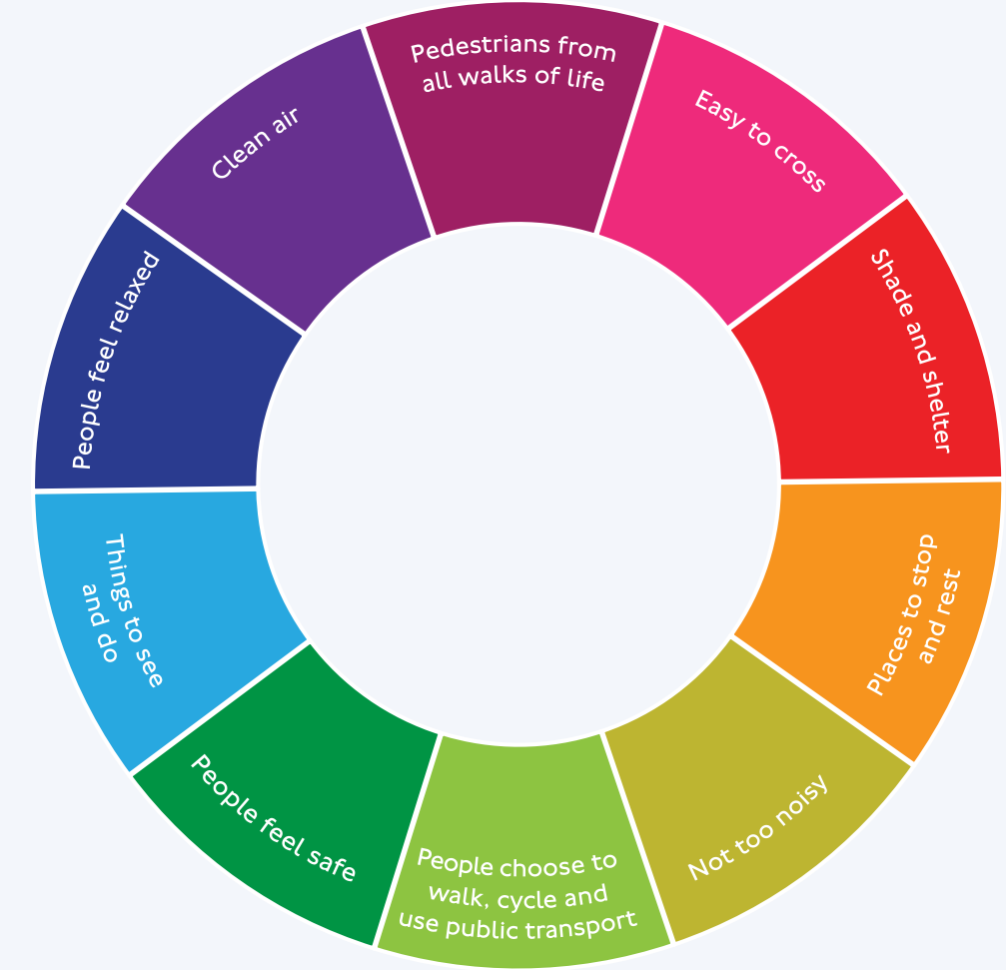
FOREIGN STRATEGIES, POLICIES
Transport for London: Walking Action Plan
(Transport for London. Walking action plan [online]. London: TfL, 2018. [cit. 2023-06-20]. Dostupné z: https://content.tfl.gov.uk/mts-walking-action-plan.pdf)

Slide 16
FOREIGN STRATEGIES, POLICIES
Urban Mobility Plan Vienna
Vienna Urban Mobility Plan scored 82 out of 100, indicating excellence in sustainable urban mobility (2015)
emphasis on public transport and its expansion, cycling, and pedestrian-friendly initiatives with their prioritization
support for shared spaces and temporary pedestrian zones
efforts to reduce car usage and promote eco-mobility
shorter wait times for pedestrians and cyclists
more intersections without traffic lights
goal: "80-20" modal split by 2025 (80% active mobility; 20% vehicles).
introduction of Vienna Mobility Card for integrated services.
decommissioning of roads in favour of pedestrians and cyclists
(Urban Development Vienna, PlanSinn GmbH, ed. Urban Mobility Plan Vienna: Short Report [online]. Vienna: Vienna City Administration, 2015. [cit. 2023-06-21]. Dostupné z: https://www.wien.gv.at/stadtentwicklung/studien/pdf/b008444.pdf)

Slide 17
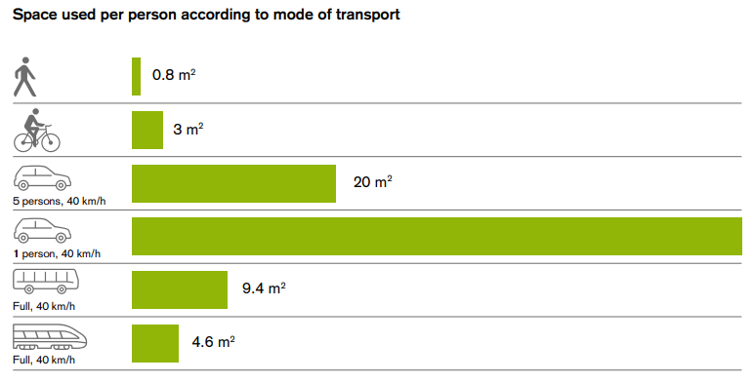
FOREIGN STRATEGIES, POLICIES
Urban Mobility Plan Vienna
(Urban Development Vienna, PlanSinn GmbH, ed. Urban Mobility Plan Vienna: Short Report [online]. Vienna: Vienna City Administration, 2015. [cit. 2023-06-21]. Dostupné z: https://www.wien.gv.at/stadtentwicklung/studien/pdf/b008444.pdf)

Slide 18
FOREIGN STRATEGIES, POLICIES
Masterplan Gehen - Stadt Salzburg
Greenpeace ranked Salzburg as Austria's most pedestrian-friendly city in 2017
Salzburg prioritizes walking as the primary mode of transportation
city aims to increase pedestrian mode share to 21% (from 18%)
initiatives include expanding pedestrian infrastructure, creating walkable neighbourhoods, improving signage, fostering a culture of mobility, and enhancing public transport integration
collaboration with neighbouring municipalities and data monitoring are key components of their strategy
recognizing the importance of pedestrian statistics is crucial for urban planning and development
(Komobile Gmunden GmbH, Stadtgemeinde Salzburg, ed. Masterplan Gehen - Stadt Salzburg [online]. 1. Salzburg: Samson Druck, 2021. [cit. 2023-06-18]. Dostupné z: https://www.stadt-salzburg.at/fileadmin/landingpages/verkehr/masterplan_gehen_broschuere.pdf)

Slide 19
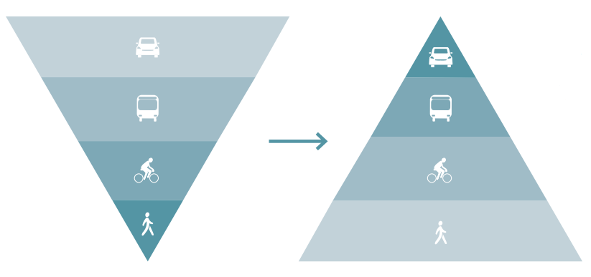
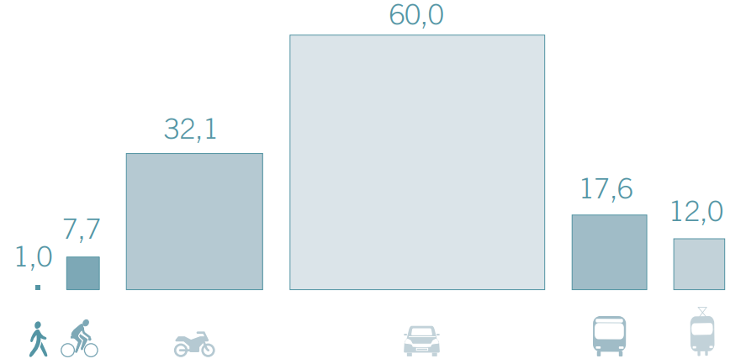
FOREIGN STRATEGIES, POLICIES
Masterplan Gehen - Stadt Salzburg
(Komobile Gmunden GmbH, Stadtgemeinde Salzburg, ed. Masterplan Gehen - Stadt Salzburg [online]. 1. Salzburg: Samson Druck, 2021. [cit. 2023-06-18]. Dostupné z: https://www.stadt-salzburg.at/fileadmin/landingpages/verkehr/masterplan_gehen_broschuere.pdf)

Slide 20
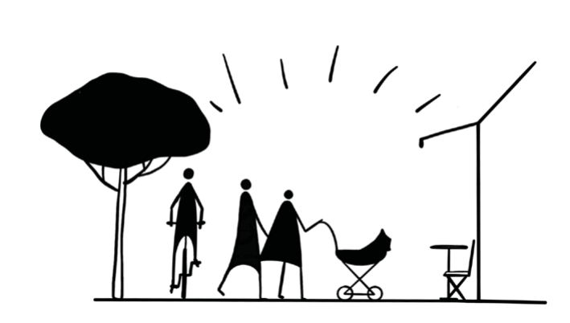
LOCAL STRATEGIES, POLICIES
Strategie aktivní mobility v Praze
shift car trips under 1.5 km to walking, promote walking & cycling
improve urban infrastructure, walkable urban development, pedestrian-friendly streets
enhance safety & access, safe school routes, child & elderly safety
create pedestrian zones in key public spaces
30 km/h zones
public transport integration, B+R, P+R
better infrastructure maintenance
public-private collaboration to promote active mobility
(ŠESTÁK, Daniel, Vojtěch NOVOTNÝ a Yussuf ZACHAR. Mott MacDonald CZ, spol. s r. o. Strategie aktivní mobility v Praze [online]. Praha, 2022, 81 s. [cit. 2023-08-19]. Dostupné z: https://iprpraha.cz/assets/files/files/87b4ebf26cb977aef979b38a55f7502b.pdf)

Slide 21
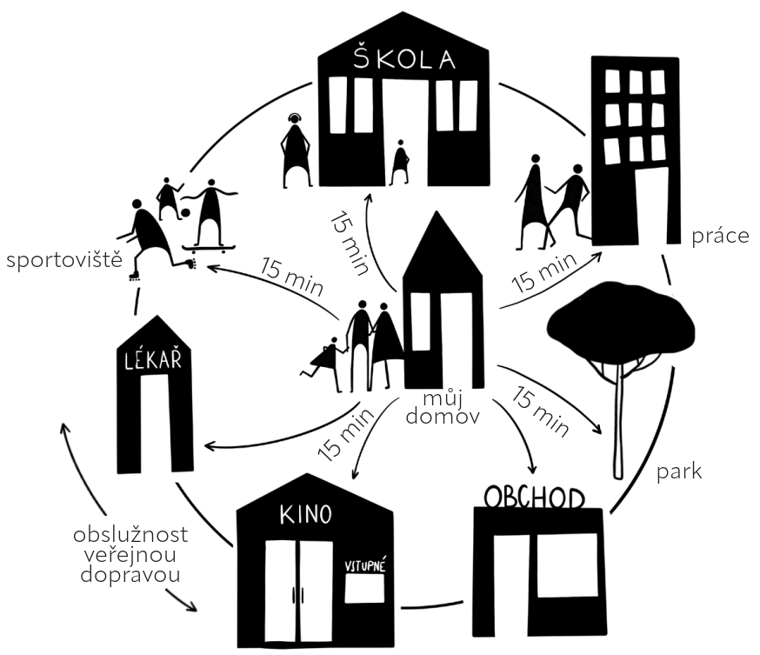
LOCAL STRATEGIES, POLICIES
Strategie aktivní mobility v Praze
(ŠESTÁK, Daniel, Vojtěch NOVOTNÝ a Yussuf ZACHAR. Mott MacDonald CZ, spol. s r. o. Strategie aktivní mobility v Praze [online]. Praha, 2022, 81 s. [cit. 2023-08-19]. Dostupné z: https://iprpraha.cz/assets/files/files/87b4ebf26cb977aef979b38a55f7502b.pdf)

Slide 22
LOCAL STRATEGIES, POLICIES
Plán udržitelné městské mobility statutárního města Pardubice
mobility and safety for all, environment-friendly transportation
pedestrian mobility to represent 30% of travel by 2035.
proposes a network of vital pedestrian routes connecting key destinations
focus on safety, accessibility, and quality of pedestrian infrastructure
plans to upgrade crossings, enhance infrastructure, and build new footbridges, over 60% of pedestrian infrastructure meets standards now
investments into barrier removal and improved lighting
city commits to enhance pedestrian safety, accessibility, and urban quality
(UDIMO, spol. s r.o.. Plán udržitelné městské mobility statutárního města Pardubice: NÁVRHOVÁ ČÁST [online]. 2022, 177 s. [cit. 2023-08-17]. Dostupné z: https://parduplan.cz/wp-content/uploads/2023/08/Navrhova-cast.pdf)

Slide 23
LOCAL STRATEGIES, POLICIES
Plán udržitelné městské mobility Liberec – Jablonec nad Nisou
prioritizing pedestrian and non-motorized transport, enhancing public transport, and improving city communication
creating quality public spaces, attractive public transport
prioritize pedestrian-friendly areas, expand sidewalks, transform main roads, revitalize squares, create connections, develop promenades (vision 2030)
eliminate transit traffic, revitalize streets for pedestrians, cyclists, and public transport, prioritize non-motorized transportation, improve pedestrian connections (vision 2050)
(NDCON, spol. s r. o. a SPF Group, s. r. o. Plán udržitelné městské mobility Liberec – Jablonec nad Nisou 2021-2030: Návrhová část [online]. 2021, 271 s. [cit. 2023-08-16]. Dostupné z: https://www.liberec.cz/files/dokumenty/odbory/odbor-strategickeho-rozvoje-dotaci/sump/navrhova_cast_04_06_posledni-aktualni-verze.pdf)

Slide 24
Thank You for paying attention

